Slide 1
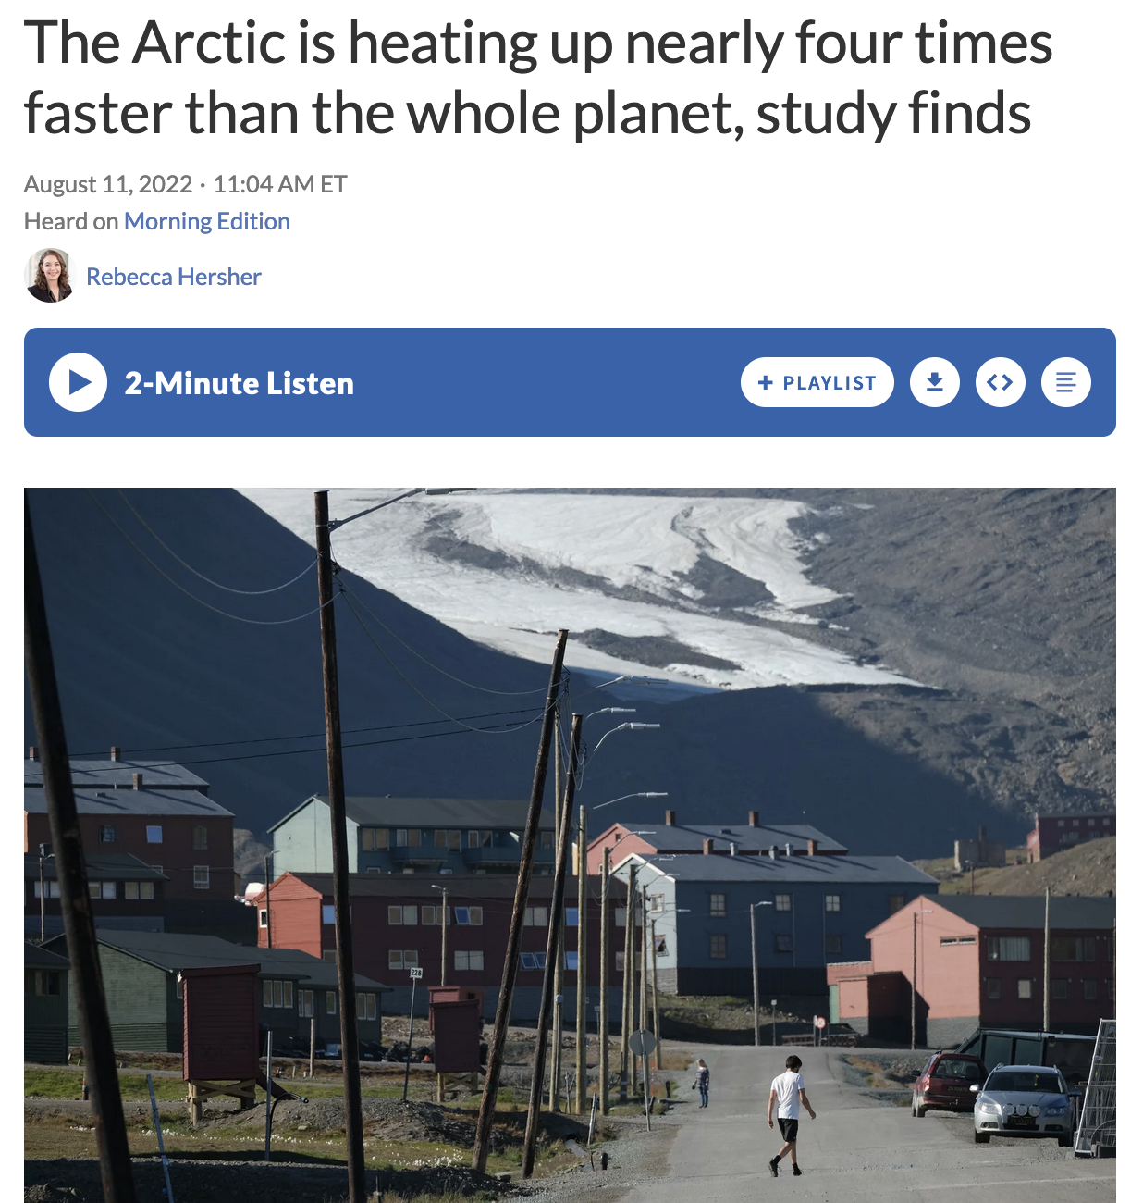
Warming in the Arctic (NPR)
https://www.npr.org/2022/08/11/1116608415/the-arctic-is-heating-up-nearly-four-times-faster-than-the-rest-of-earth-study-f

Slide 2
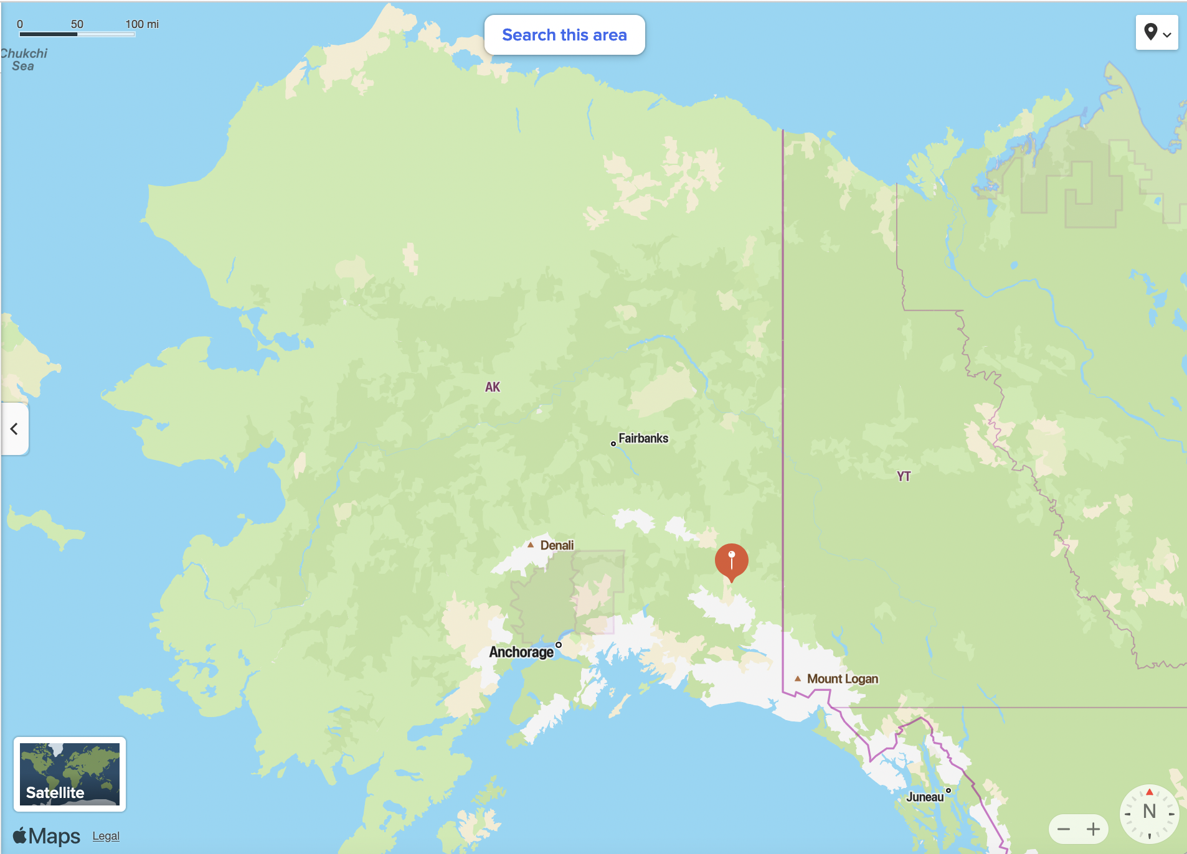
People in the Arctic: at Nabesna and Utqiagvik
Utqiagvik
Nabesna

Slide 3
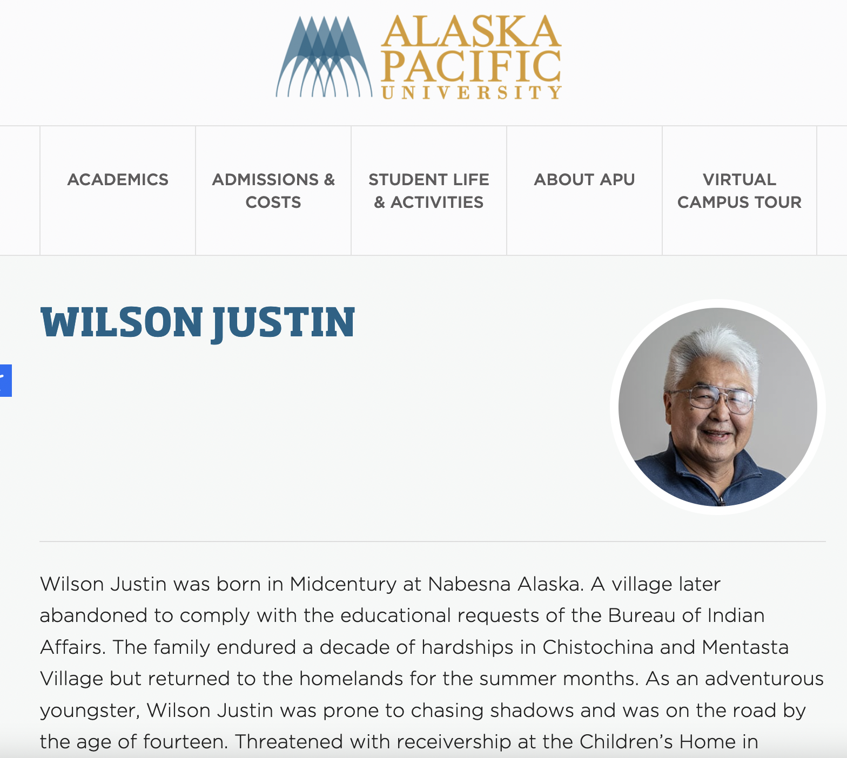
Wilson Justin, Althsetnay Clan (Nabesna)
Utqiagvik
Nabesna

Slide 4
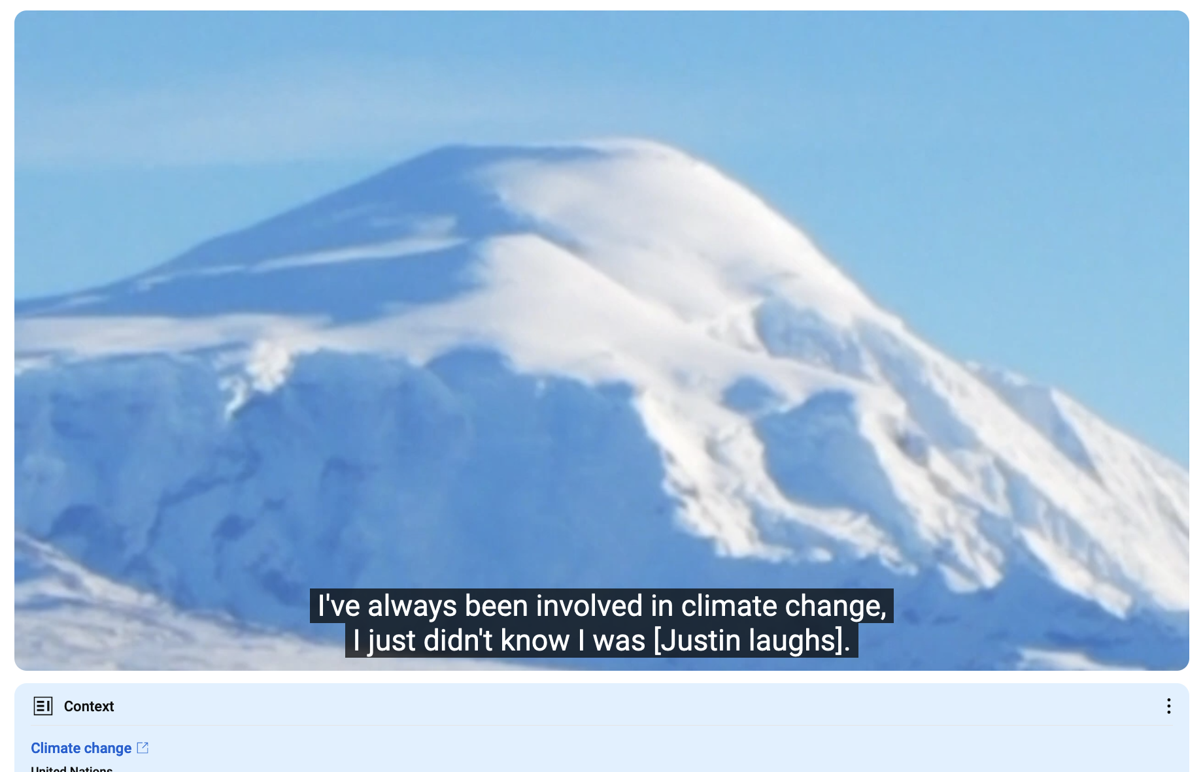
Wilson Justin, Althsetnay Clan (Nabesna)
https://youtu.be/gBBffAtqMsc
https://youtu.be/gBBffAtqMsc?t=462

Slide 5
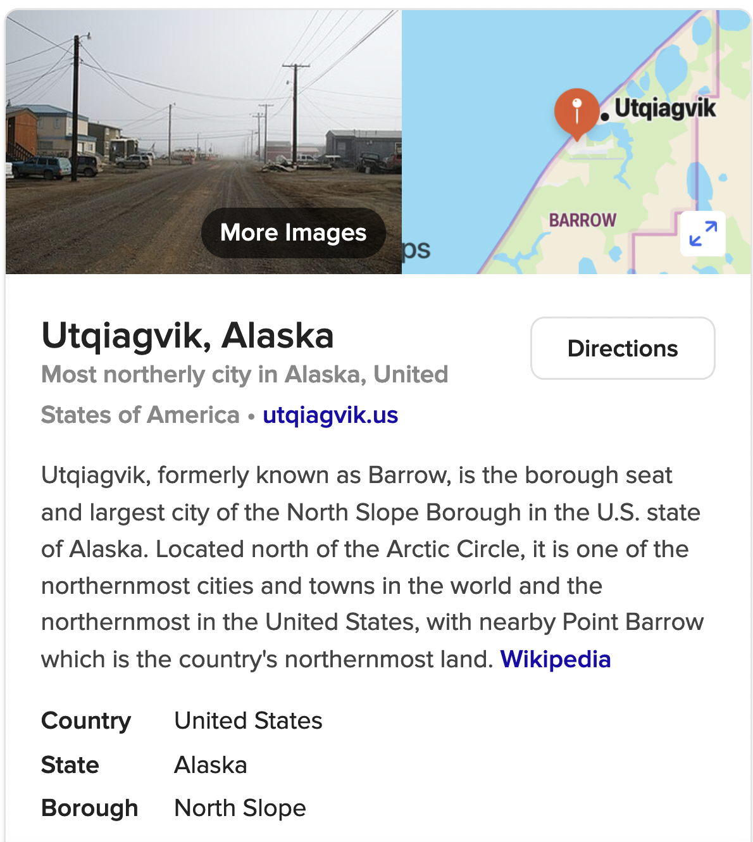
Utqiagvik (formerly Barrow, formerly Utqiagvik)
Utqiagvik
Nabesna

Slide 6
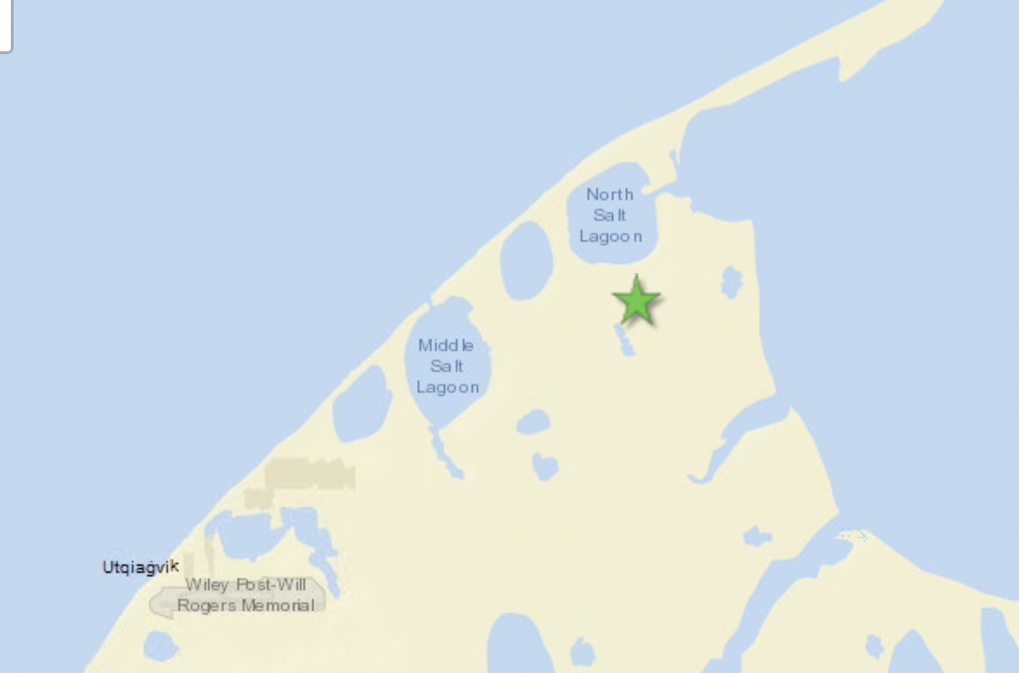
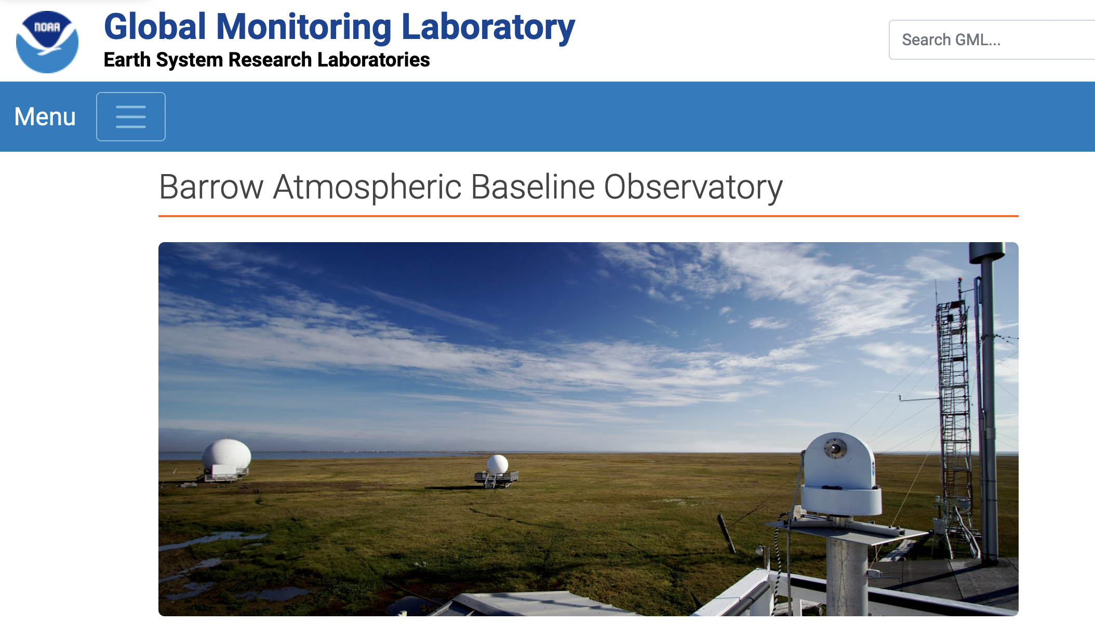
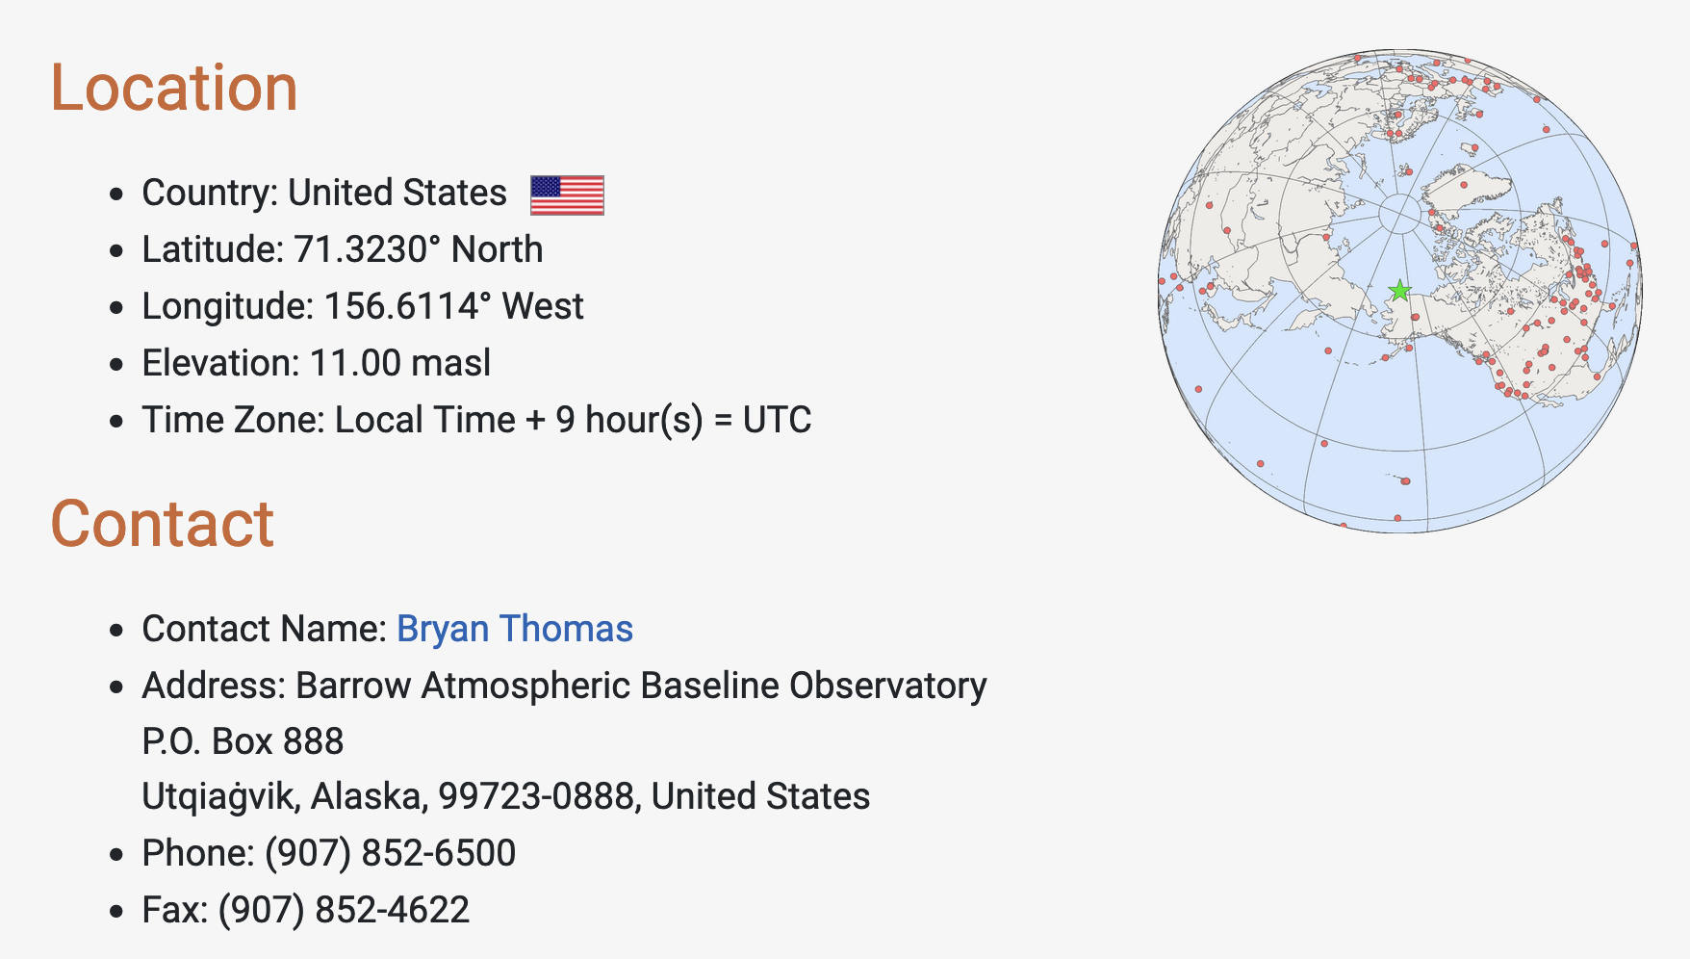
The NOAA lab at Utqiagvik (formerly Barrow, formerly Utqiagvik)
Utqiagvik
BRW station
Utqiagvik
(½ hour by snowmobile)
NOAA lab
Nabesna
https://gml.noaa.gov/obop/brw/

Slide 7
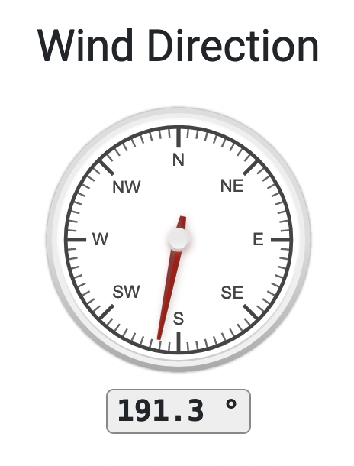
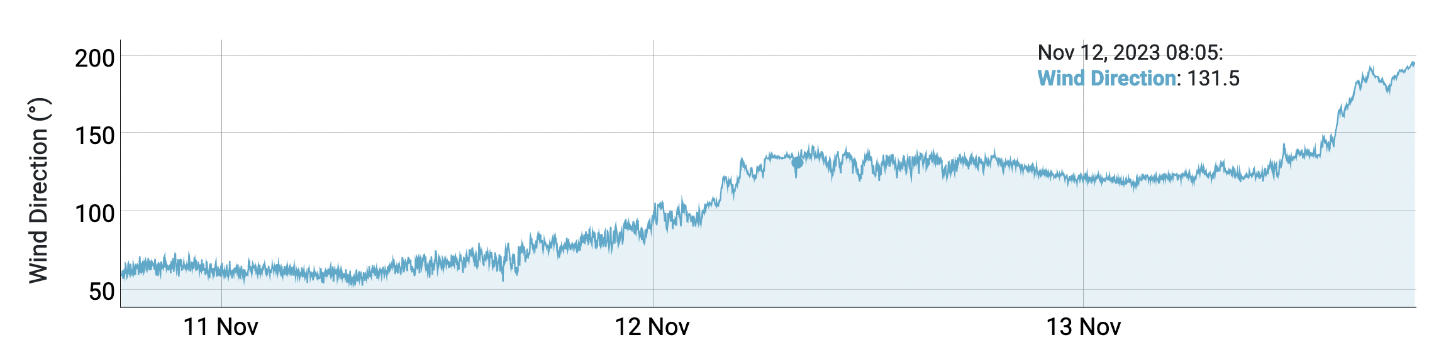
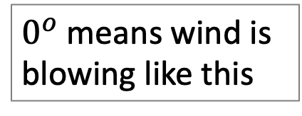
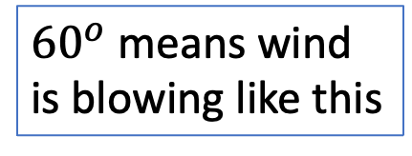
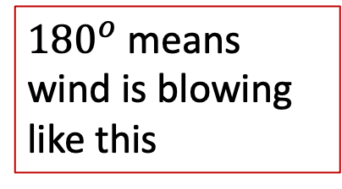
Wind direction is where wind is coming from, with north=0, clockwise
$0^{o}$ means wind is blowing like this
${180}^{o}$means wind is blowing like this
${60}^{o}$ means wind is blowing like this

Slide 8
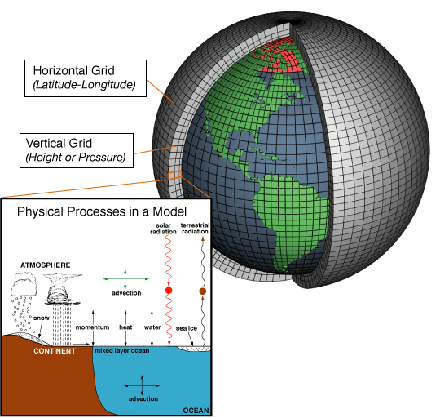
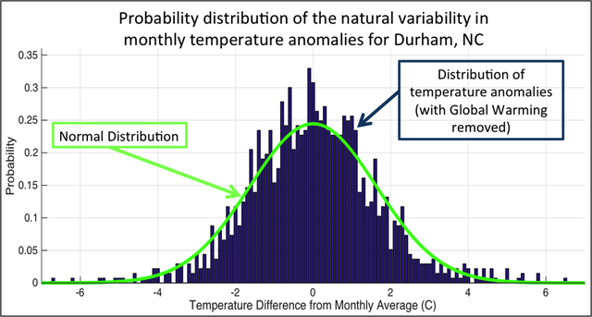
What exactly are we trying to represent when we model climate?
We’ve seen a lot of geographical variability in the observational record (EdGCM). How about temporal variability at a given location?

Slide 9
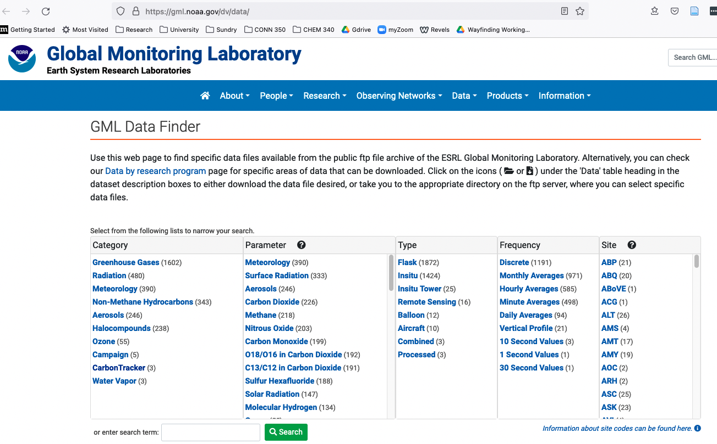
NOAA archive
https://gml.noaa.gov/dv/data/, Navigate to Meteorology, Hourly Averages, BRW
Data
Metadata

Slide 10
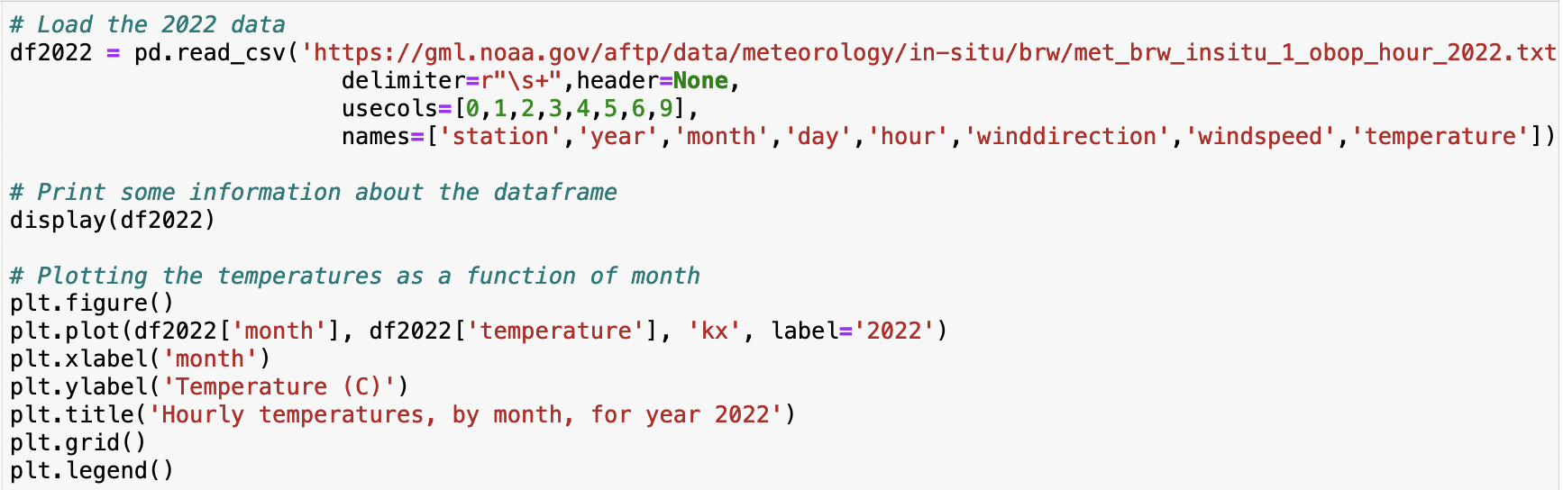
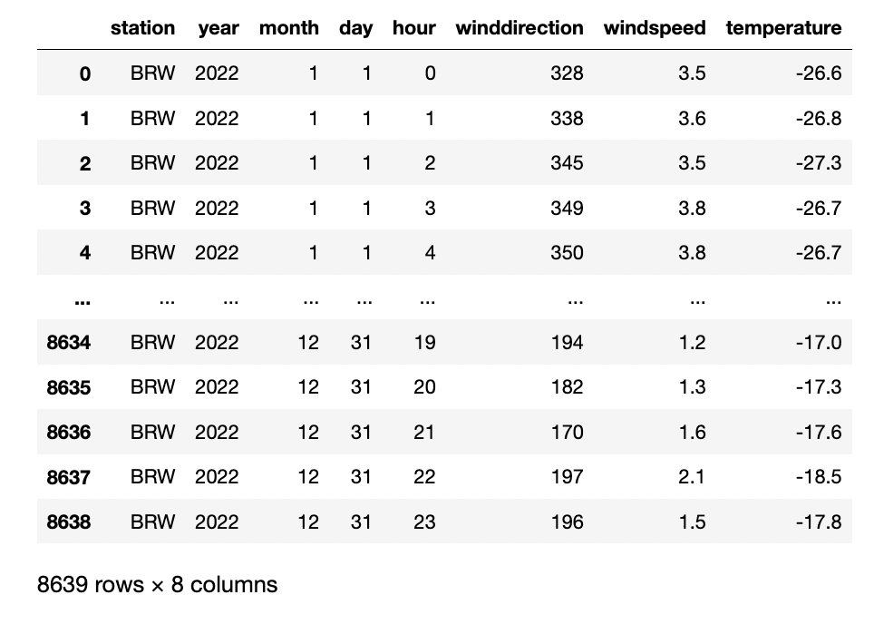
PANDAS loads and displays that kind of data as a dataframe

Slide 11
Python can graph selected parts of the dataframe

Slide 12
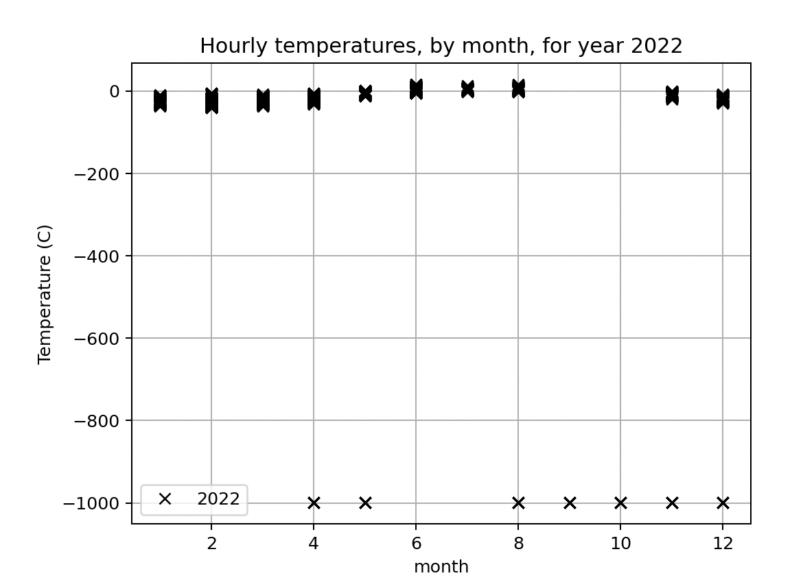
What you download generally needs some quality control

Slide 13
What you download generally needs some quality control
Good data
Bad data

Slide 14
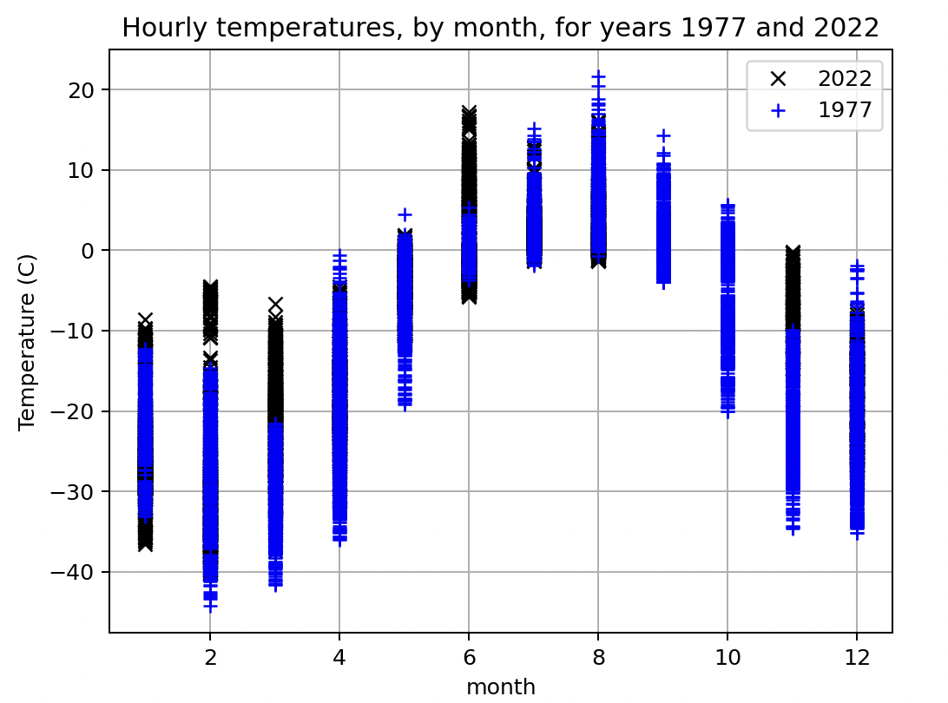
What you download generally needs some quality control
Good data
Bad data

Slide 15
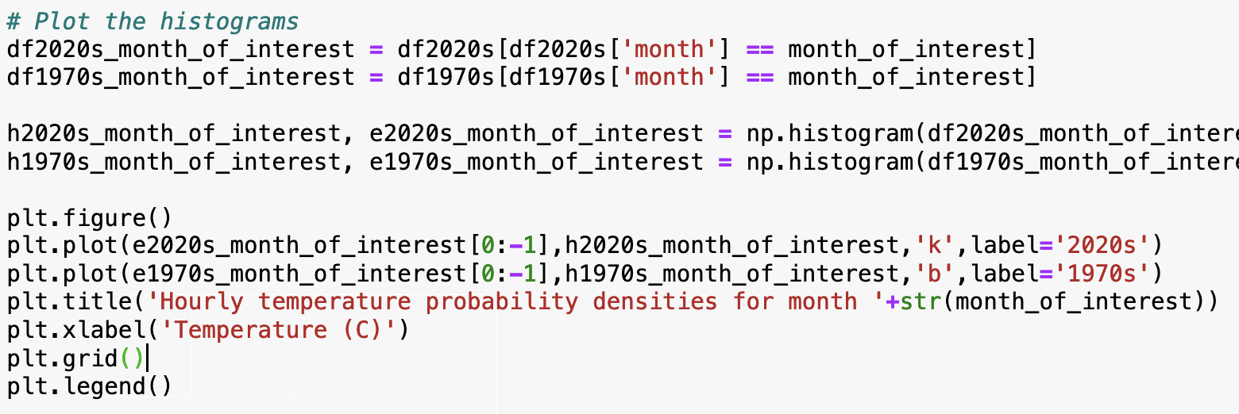
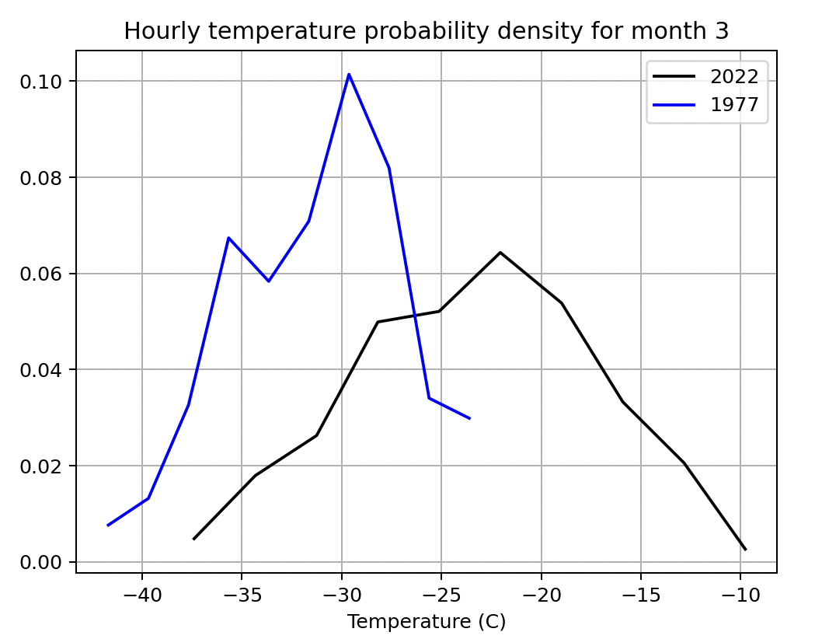
Once you have got rid of the bad data, you can do some statistics

Slide 16
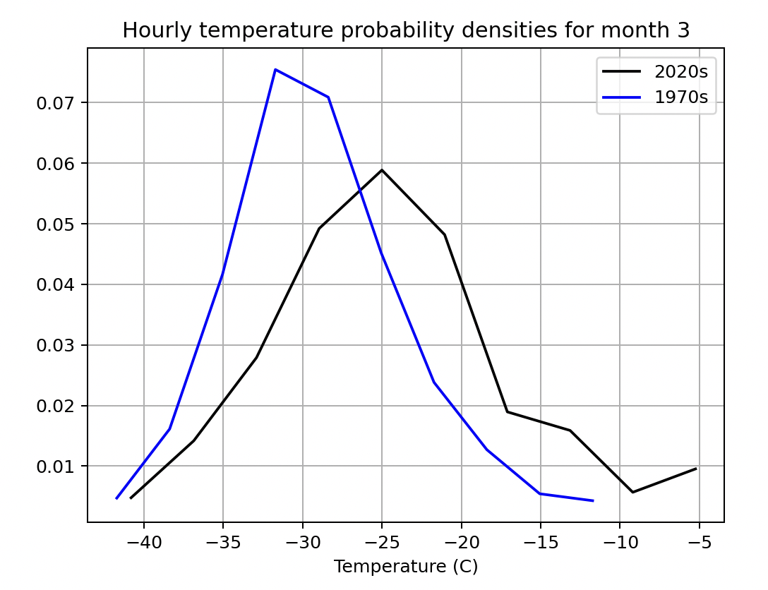
You can see what averaging over more years can do for you
1-year datasets
3-year datasets

